Slide 1
CSF 2113 Programming for Information Security
CLO2: Advanced Concepts in Functions and Modules
Muhammad Humayoun, PhD
Assistant Professor
mhumayoun@hct.ac.ae
Abu Dhabi Men’s College

Slide 2
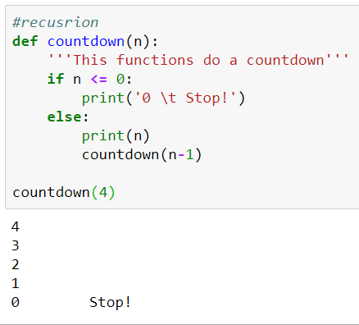
Recursion
A way of programming, in which a function calls itself
Base case /
termination condition
Iterations can be formulated using recursion

Slide 3
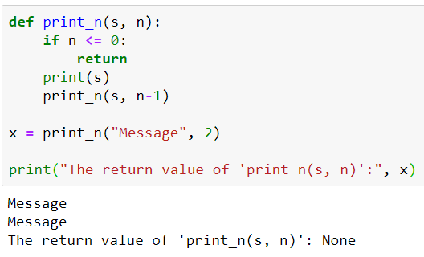
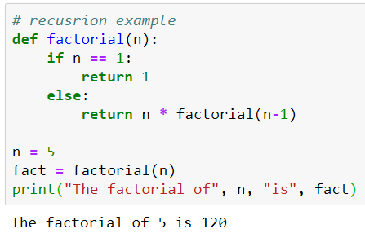
Two more recursive functions

Slide 4
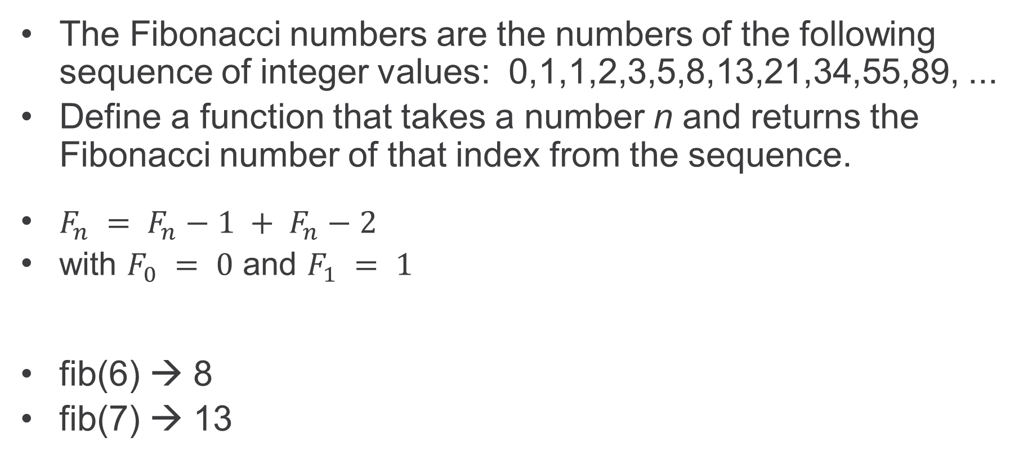
Activity: Fibonacci Numbers
The Fibonacci numbers are the numbers of the following sequence of integer values: 0,1,1,2,3,5,8,13,21,34,55,89, ...
Define a function that takes a number n and returns the Fibonacci number of that index from the sequence.
$F_{n} = F_{n}−1 + F_{n}−2$
with $F_{0} = 0$ and $F_{1} = 1$
fib(6) → 8
fib(7) → 13

Slide 5
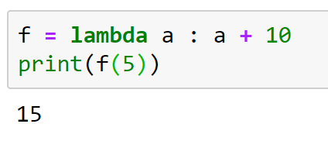
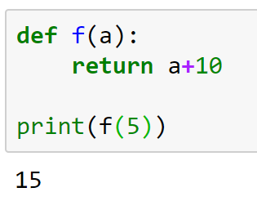
Anonymous functions (Lambda expression)
A lambda function is a small anonymous function.
A lambda function can take any number of arguments, but can only have one expression.
lambda arguments : expression
Example:
Same as

Slide 6
More examples
x = lambda a, b : a * b print( x(5, 6) )
x = lambda a, b, c : a + b + c print( x(5, 6, 2) )

Slide 7
Generator functions
A special kind of function that return a lazy iterator.
Lazy iterator is an object that you can loop over like a list.
Unlike lists, lazy iterators do not store their contents in memory
Example usage:
Generating an Infinite Sequence
Reading Large Files

Slide 8
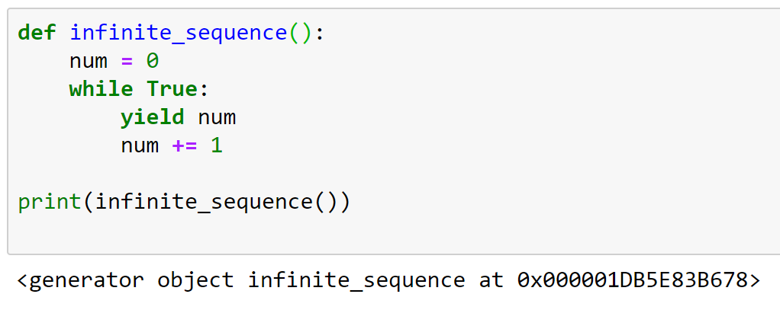
yield statement
Syntactically, Generator functions look and act just like regular functions
One difference: Generator functions use yield instead of return

Slide 9
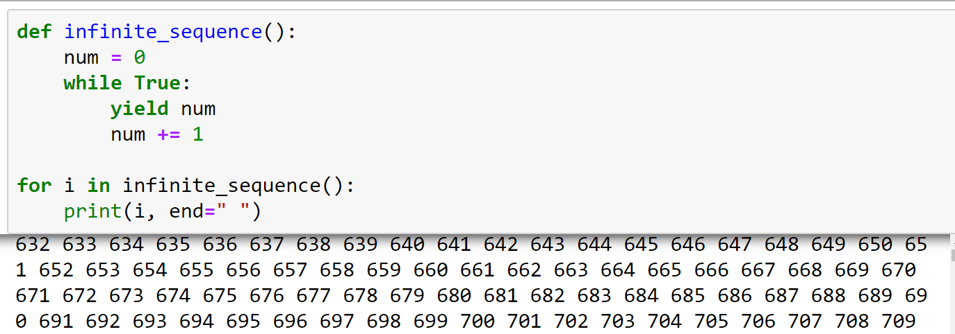
How to use it?
The program will continue to execute until you stop it manually.

Slide 10
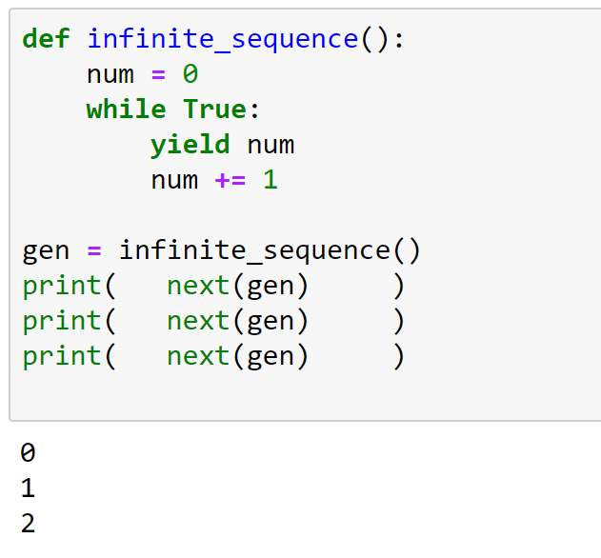
How to use it?
Instead of using a for loop, you can also call next() on the generator object directly

Slide 11
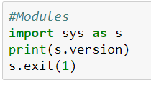
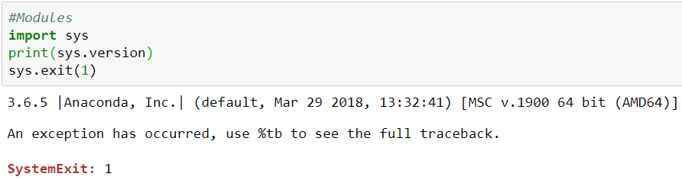
Modules
The large Python community has written a module for nearly all the problems on earth
You can download them for free including their source code and utilize them in your own programs
In the coming lectures we will make extensive use of Pythons module system
You load a module with the help of the import keyword
Alternatively:

Slide 12


Modules
If you would like to apply functions without prepending their module name you must import them as follows:
A special solution to import all functions of a module exists via * but the author advises not using, because it can lead to ugly, very hard to debug name collision.

